Slide 2
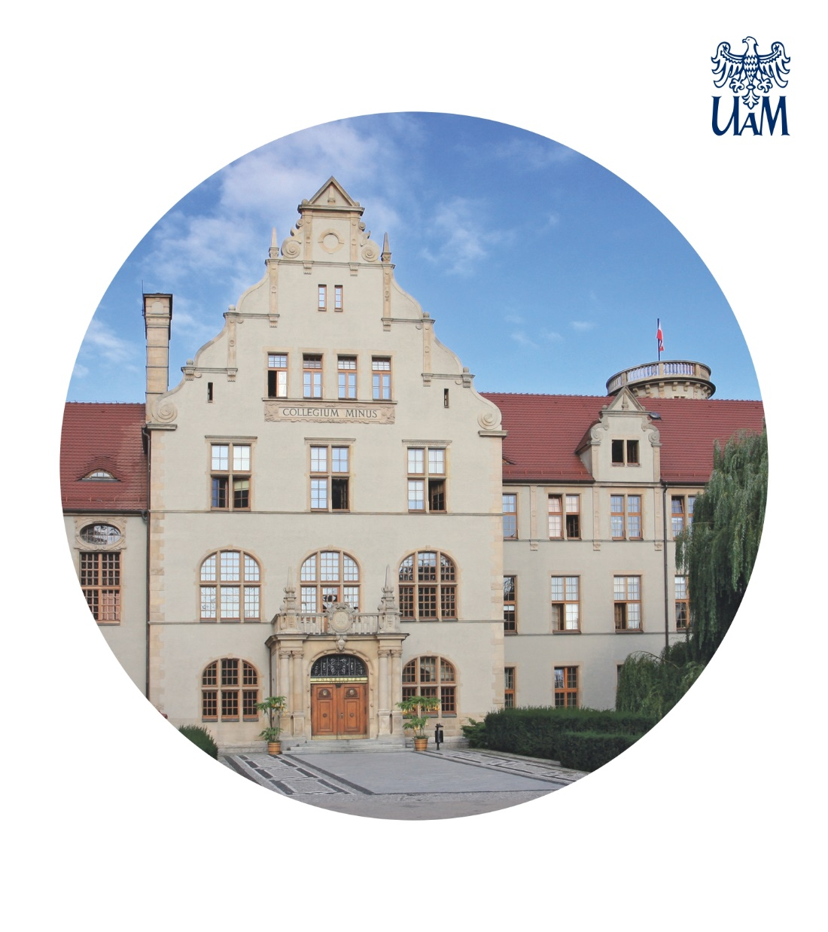
AMU is one of the best academic centres in Poland. Its beginnings and renown go back as far as the early 16th century. At that time, it was already known for its scientific and scholarly achievements, its attractive study programmes and excellent infrastructure.
AMU offers 141 study programmes and 63 specializations. It has over 29 thousand B.A. and M.A. students. There are also 1200 Ph.D. students at AMU Doctoral Schools. AMU also offers a number of post-graduate studies and special courses. According to the Perspektywy monthly, AMU is one of the three best universities in Poland. An AMU diploma opens the doors to attractive careers.

Slide 3
AMU is a member of the EPICUR Consortium, a European Partnership for an Innovative Campus Unifying Regions. Members of the consortium include 9 universities from seven European countries.
The supranational alliance of the organizations emphasizes one of the goals of the consortium which is to increase student and staff mobility as well as to support quality, integration and competitiveness of the European higher education.
EPICUR has received from the European Commission an 18 million Euro implementation grant for its development until the year 2030.

Slide 4
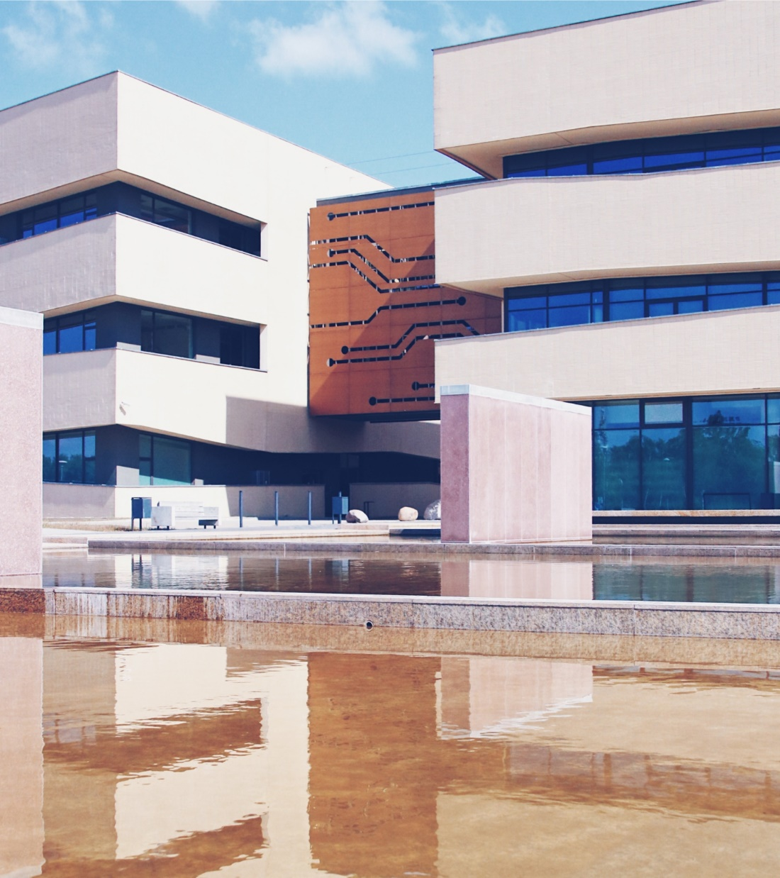
AMU belongs to ten top-ranging Polish universities. Within the framework of Excellence Initiative, the university acquires additional financial resources for the development of research and for internationalization facilitating effective competition with the best academic centres in Europe and around the world.

Slide 5
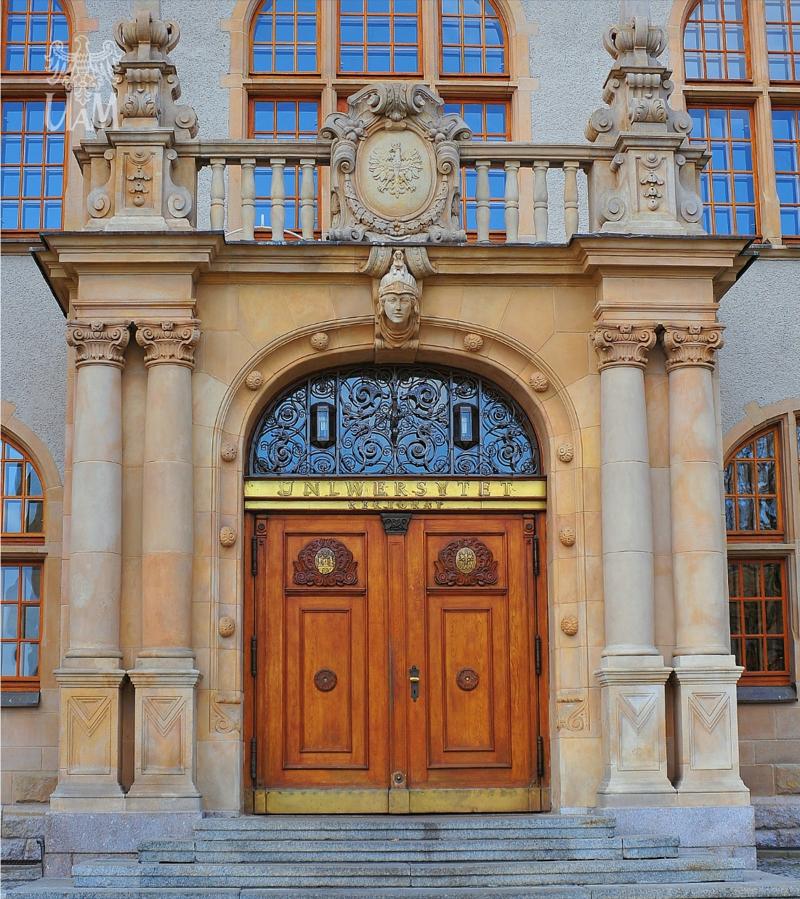
AMU has a number of specialized research centres such as:
14C AMS Laboratory (LAMS)
Adam Mickiewicz University Centre for Innovation and Technology Transfer
Centre for Advanced Technologies
Centre for Migration Studies
Centre for Open Humanities
Centre for European Integration
Centre for Integrated Environmental Monitoring
Edith Stein Research Centre
Metropolitan Research Centre
NanoBioMedical Centre
Polish Archaeological Institute at Athens
Research Centre for Public Engagement of Women

Slide 6
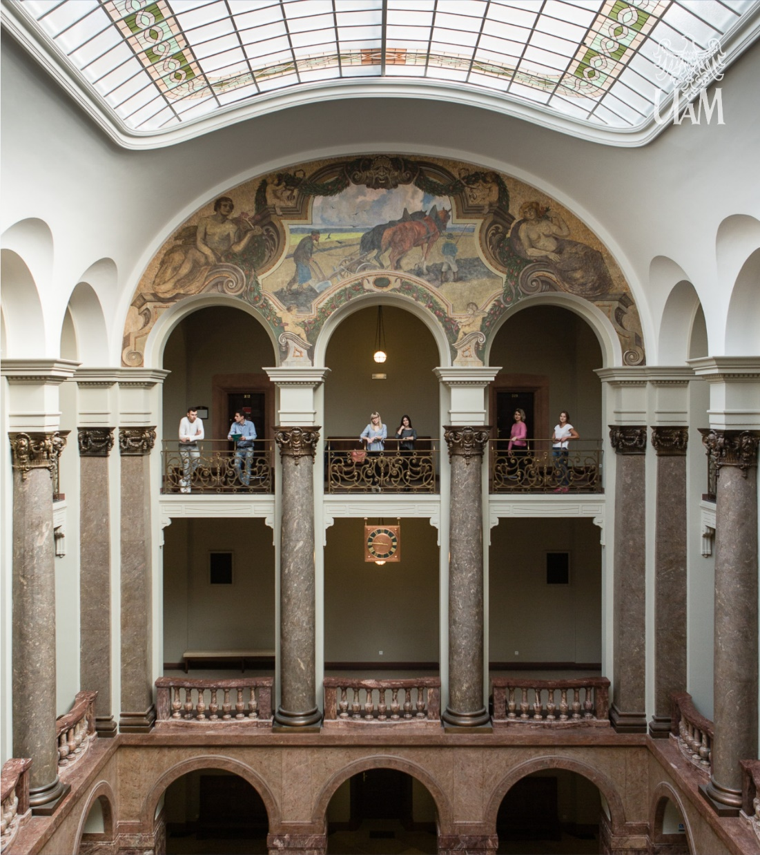
Following the principles of the equal opportunity and anti-discriminatory policy, AMU’s organizational culture promotes equal treatment, appreciates diversity and protects the dignity of all people irrespective of their gender, age, disabilities, ethnic and national origin, political convictions, race, religion or its absence, sexual identity or psychosexual orientation.
AMU’s culture of integration includes among others effective support to the disabled, innovations in the process of teaching, the elimination of architectural barriers and broadening its scope of assistance and care.

Slide 7
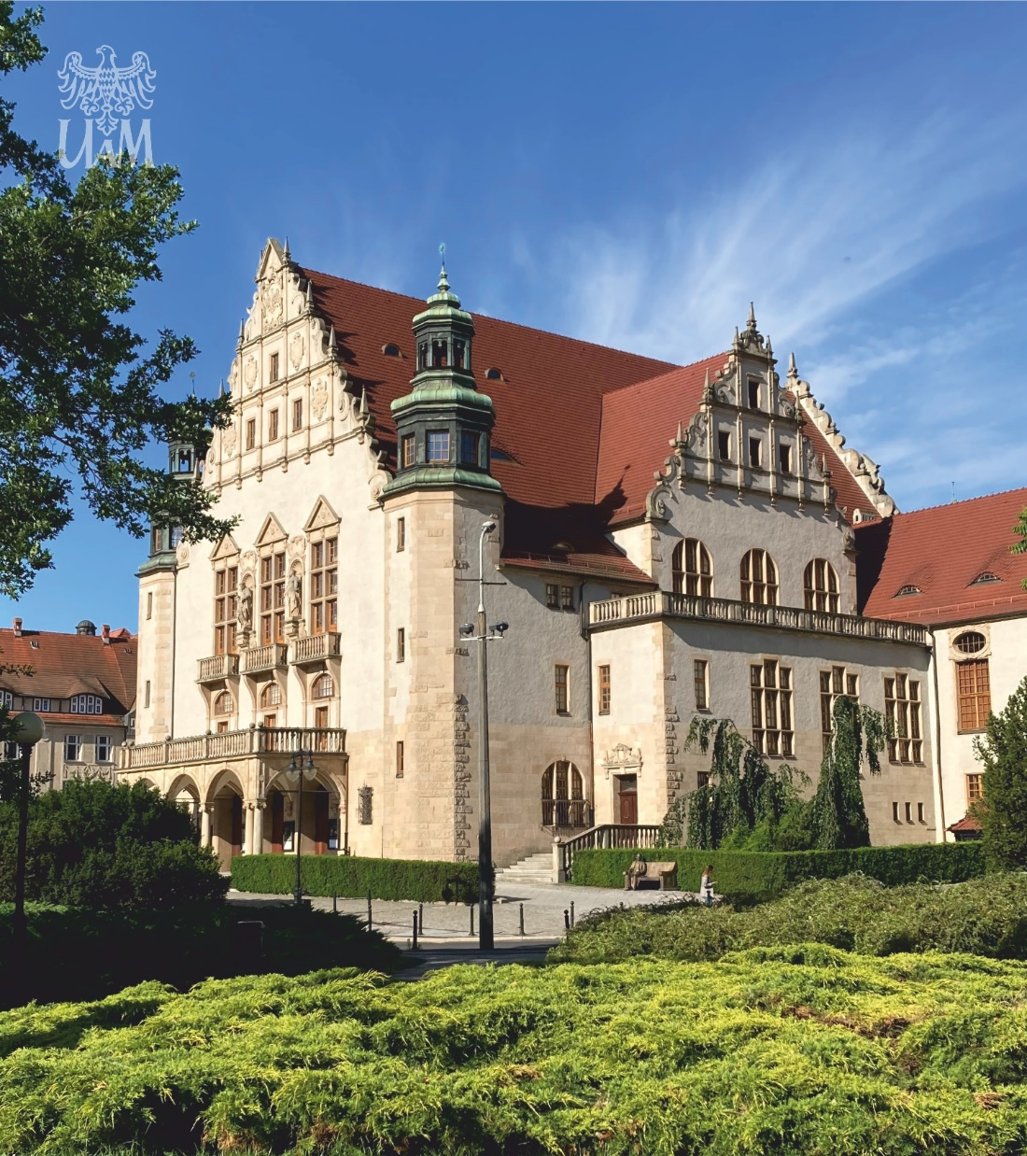
AMU was the first Polish University to receive its accreditation from the Accreditation Council for Entre-preneurial and Engaged Universities (ACEEU) and the title of an engaged university. This is the only accreditation to evaluate the university’s social engagement, cooperation with the social environment and non-university partners, as well as the implementation of the idea of social responsibility including sustainable development.
For years, AMU has been investing in ecological solutions such as renewable energy sources and excels among Polish higher education institutions in the ‘green ranking’ by the World University Ranking ‘Green Metric’.

Slide 8
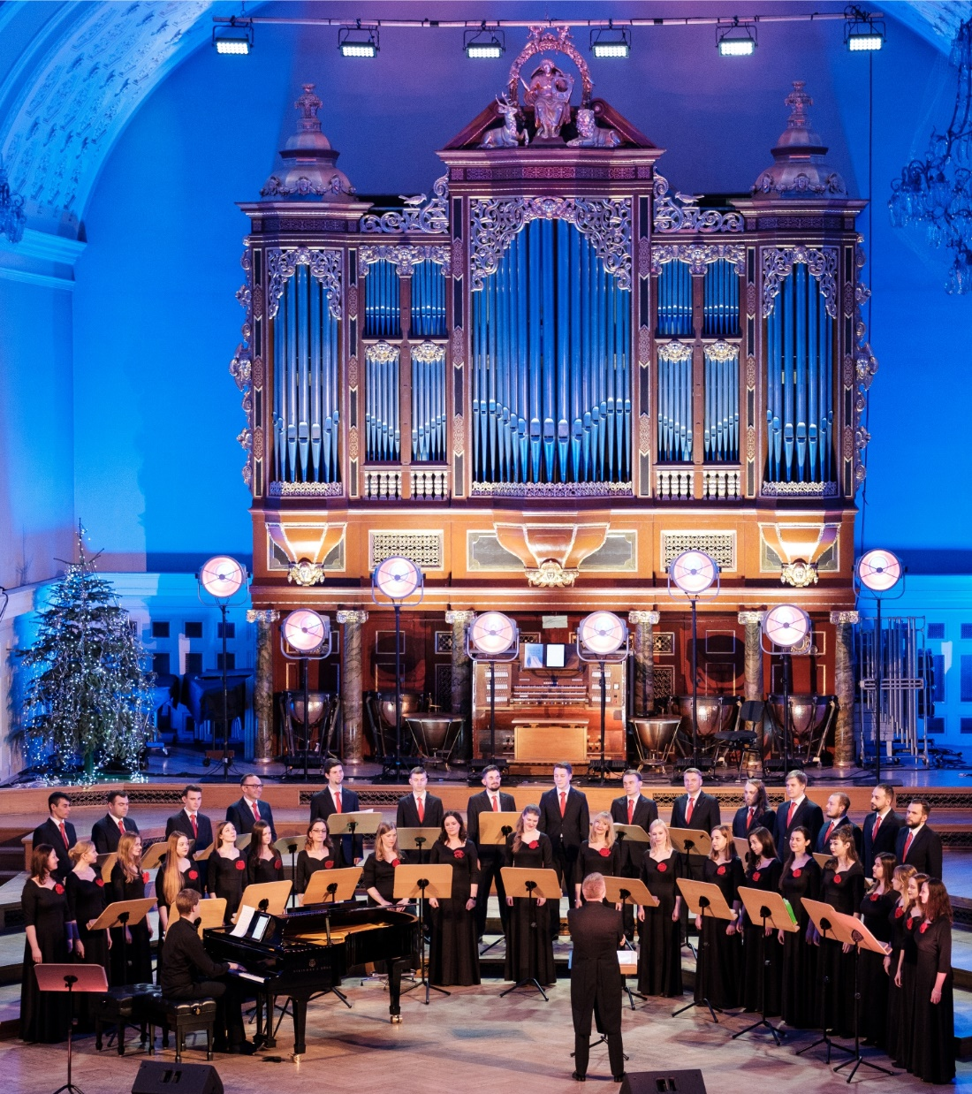
University is not only about science. AMU prides itself on its vibrant ensembles of Chamber Choir, Academic Choir, Chamber Orchestra and many student theatre and cabaret groups. The University, together with the City of Poznań, is the founder of the prestigious the Poznań Literary Award, which is awarded annually.
Cultural events organised by AMU include: concerts, exhibitions, recitation competitions or even the largest collection of comic books in Poland housed in the University Library.
AMU is also the most sport-oriented university in Poland.
It has a well-equipped sports complex with a modern hall, an athletics stadium, tennis courts and a swimming pool. Experienced coaching staff runs numerous sports sections, and AMU representatives regularly win academic championship medals at home and abroad.

Slide 9
Faculties
Branches
Majors
Students
PH.D. students
Academic teachers
Administration staff
Domestic and international research projects
Value of National Science Centre (NCN) projects
Scientific and scholarly publications
Partner universities
21
4
141
29 861
1 148
3 016
2 238
586*
PLN 415.7 million*
4 727
338
* December 2023

Slide 10
Adam Mickiewicz University, Poznań
ul. Wieniawskiego 1, 61-712 Poznań, Poland

